Slide 1
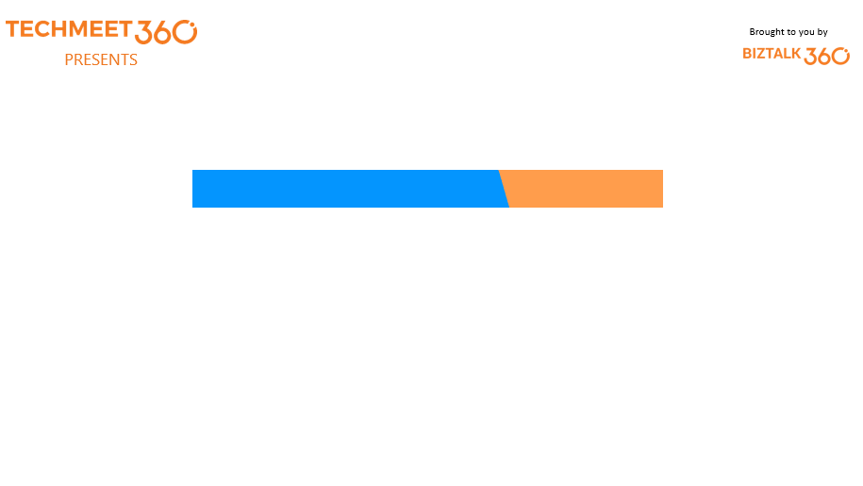
TechTalk Thursday – 80th Episode
Orange Room, BizTalk360
16th May’19
Pandiyan Murugan
Senior Software Engineer
Tools for Fast Angular Applications

Slide 2

What today?
Network Performance
Tips and Tricks
Application in Production

Slide 3
Network Performance

Slide 4

Shipping less JavaScript

Slide 5
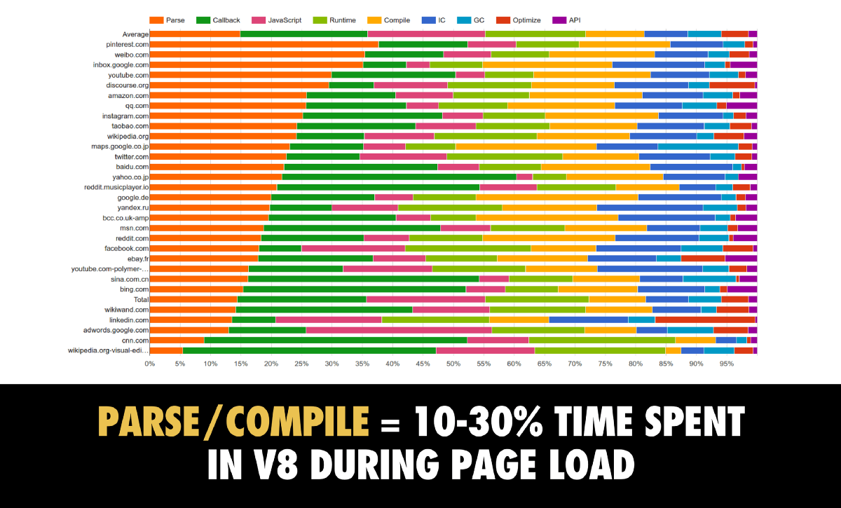

Slide 6


Slide 7
Shipping fewer bytes
Minification/Dead code elimination
Differential loading
Code splitting

Slide 8

Differential loading
Produce ES5 bundles for newer browsers
Do not send polyfills to modern browsers
Smaller payload
Do not downlevel modern features
Faster execution
Smaller payload

Slide 9
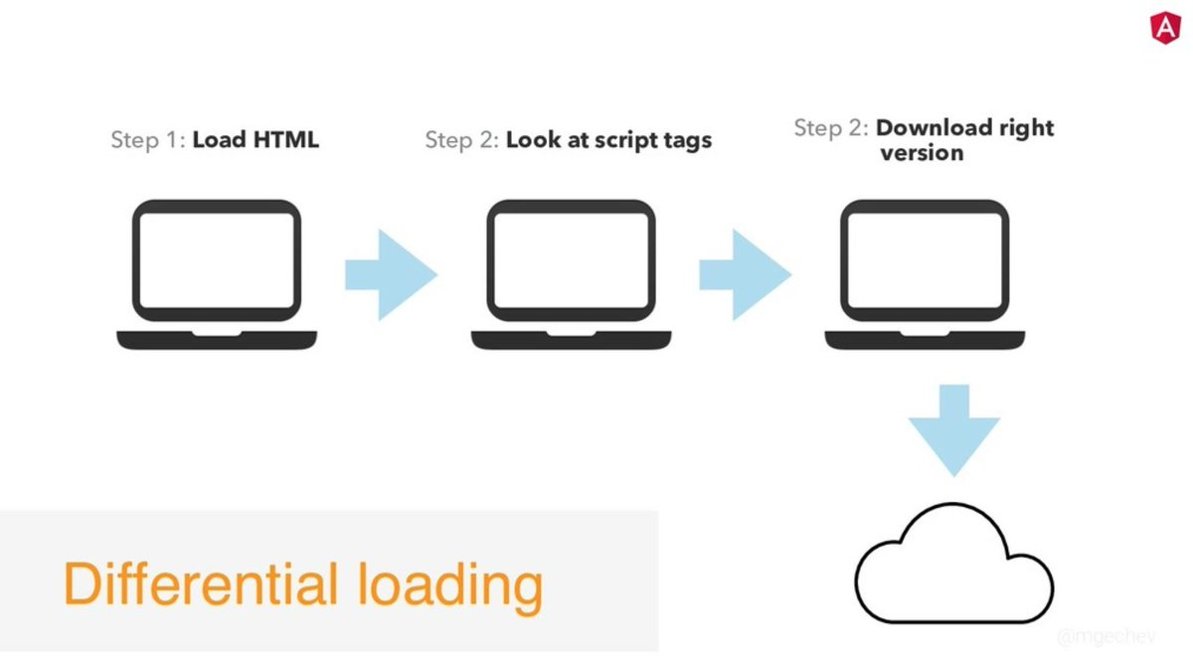

Slide 10
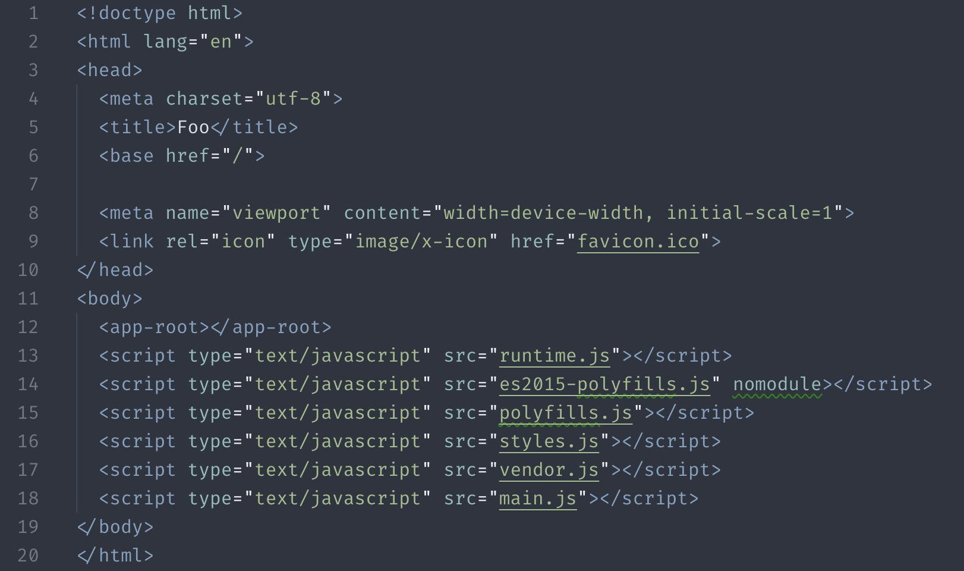

Slide 11

Code splitting

Slide 12


Code-splitting
Component-level
Route-level

Slide 13
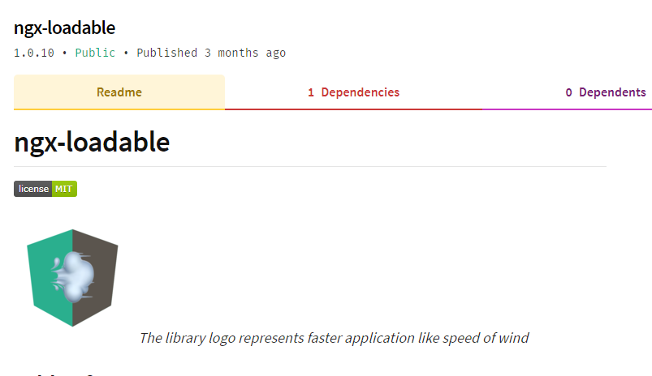

Slide 14
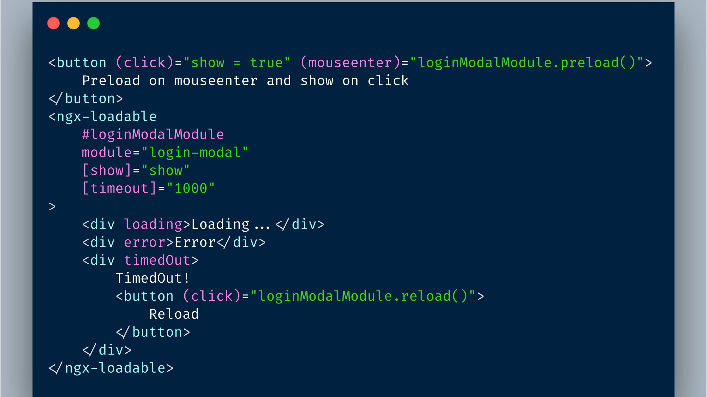

Slide 15

Prefetching strategies
Prefetch only visible links
Predictive prefetching

Slide 16
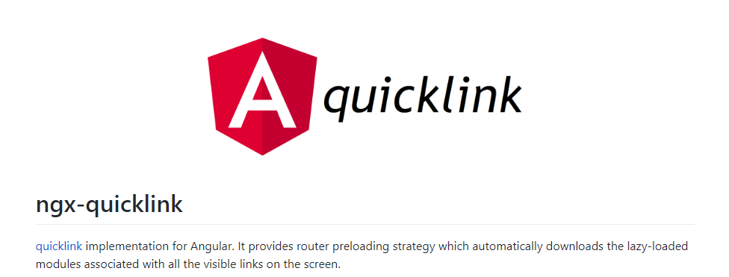
ngx-quicklink

Slide 17
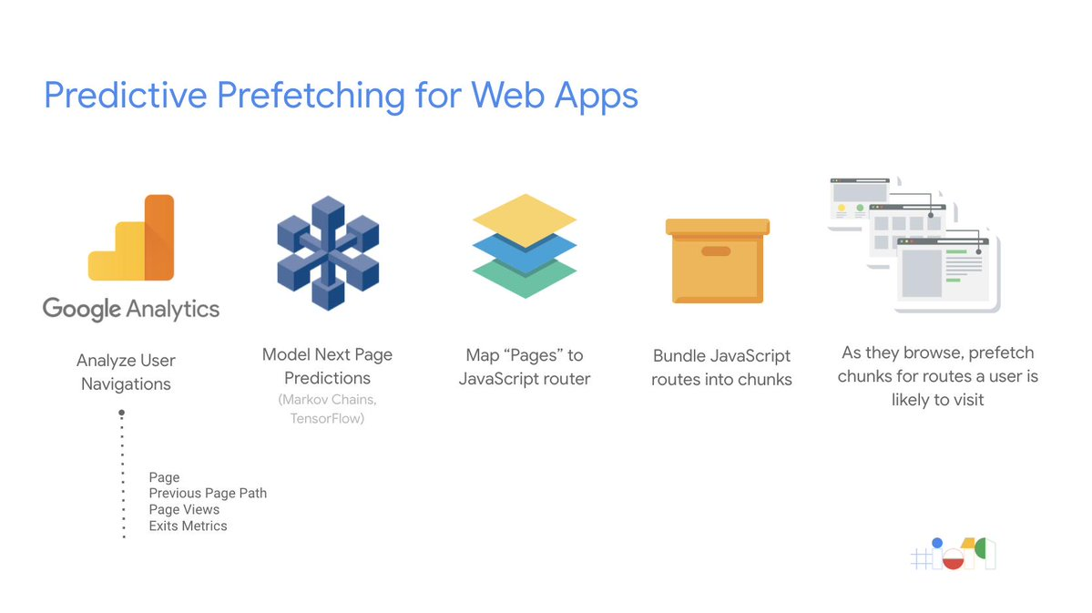

Slide 18


Slide 19
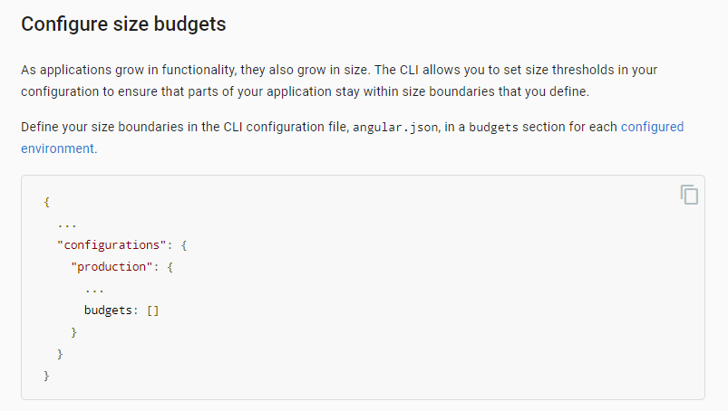

Slide 20
Angular projects without compression > 27%

Slide 21
Angular projects without CDN > 80%

Slide 22
ng run deploy

Slide 23

Take away
Reduce bundle size with differential loading
Speeding up user navigation with predictive prefetching
Automated deployment with CLI

Slide 24




/pandiyan_cool
/pandiyancool
efficientuser.com

